Slide 1
Brief introduction on Penrose inequality and its recent progresses
Run-Qiu Yang
2022-09-15@ITP

Slide 2
Contains
Basics of Penrose inequality
Proofs in spherically symmetric and time symmetric cases;
Generalizations on charged, rational cases and asymptotically AdS spacetime;
A few of recent progresses
arXiv: 0906.5566[gr-qc]
Run-Qiu Yang, Li Li and Rong-Gen Cai, 2205.08246 ;
Zi-Qing Xiao, Run-Qiu Yang, 2204.12239;
Jaroslaw S. Jaracz, 2206.12951;
Åsmund Folkestad, :2209.00013;
Netta Engelhardt, Gary T. Horowitz, 1903.00555.

Slide 3
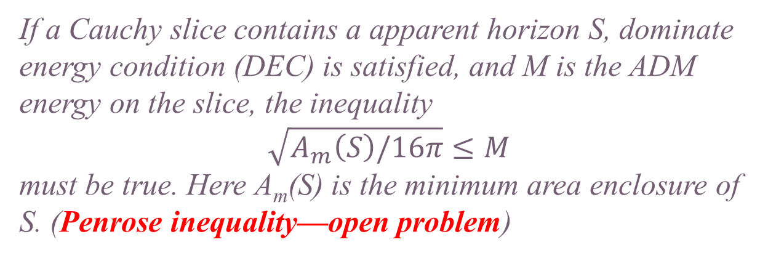
Basics of Penrose inequality
Penrose and Hawking's theorems about singularity show that spacetime singularity will be inevitable in classical case;
To keep the predicability in general relativity, it was conjectured that the singularity must be hidden into a black hole (cosmic censorship);
One theoretical test of cosmic censorship:
S
If a Cauchy slice contains a apparent horizon S, dominate energy condition (DEC) is satisfied, and M is the ADM energy on the slice, the inequality
$$\sqrt{A_{m}\left(S\right)/16π}≤M$$
must be true. Here A_{m}(S) is the minimum area enclosure of S. (Penrose inequality—open problem)
Cauchy slice
The positive energy theorem is a corollary of Penrose inequality!

Slide 4


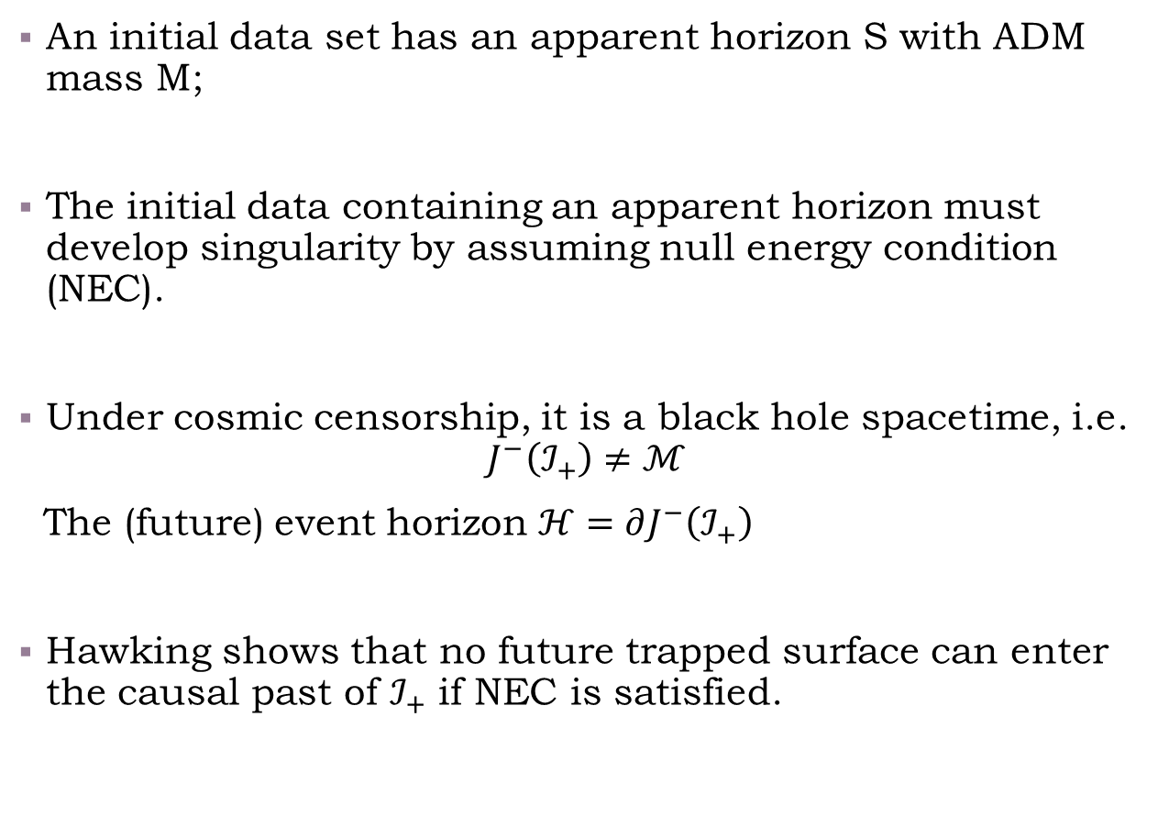










Penrose’s heuristic argument
Apparent horizon S
An initial data set has an apparent horizon S with ADM mass M;
The initial data containing an apparent horizon must develop singularity by assuming null energy condition (NEC).
Under cosmic censorship, it is a black hole spacetime, i.e.
$$J^{−}\left(ℐ_{+}\right)≠ℳ$$
The (future) event horizon $ℋ=∂J^{−}\left(ℐ_{+}\right)$
Hawking shows that no future trapped surface can enter the causal past of $ℐ_{+}$ if NEC is satisfied.
$$i_{+}$$
$$k^{μ}$$
$$ℐ_{+}$$
$$l^{μ}$$
$$ℋ$$
$$i_{0}$$
$$θ_{\left(k\right)}=0$$
$$S_{1}$$
$$ℐ_{−}$$
$$i_{−}$$
S is enclosed by $S_{1}$
$$A_{m}\left(S\right)≤A(S_{1})$$

Slide 5

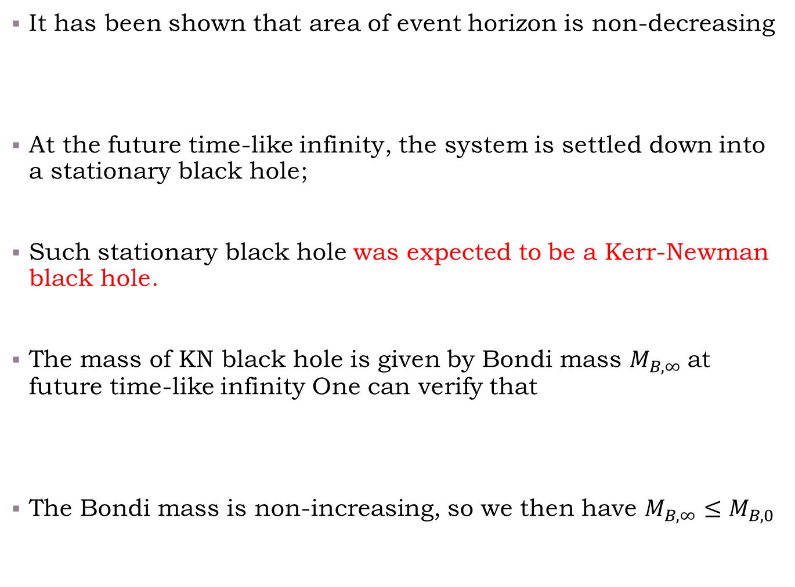






Penrose’s heuristic argument
It has been shown that area of event horizon is non-decreasing
At the future time-like infinity, the system is settled down into a stationary black hole;
Such stationary black hole was expected to be a Kerr-Newman black hole.
The mass of KN black hole is given by Bondi mass $M_{B,∞}$at future time-like infinity One can verify that
The Bondi mass is non-increasing, so we then have $M_{B,∞}≤M_{B,0}$
Apparent horizon S
$$A\left(S_{1}\right)≤A(S_{∞})$$
$$i_{+}$$
$$k^{μ}$$
$$ℐ_{+}$$
$$S_{∞}$$
$$l^{μ}$$
$$ℋ$$
$$i_{0}$$
$$θ_{\left(k\right)}=0$$
$$S_{1}$$
$$ℐ_{−}$$
$$A\left(S_{∞}\right)≤16πM_{B,∞}^{2}$$
$$i_{−}$$

Slide 6

Penrose’s heuristic argument
Apparent horizon S
Provided the Bondi mass approaches the ADM mass of the initial slice, then we have
This is the Penrose’s heuristic argument for his inequality.
$$i_{+}$$
$$k^{μ}$$
$$ℐ_{+}$$
$$S_{∞}$$
$A_{m}\left(S\right)≤A\left(S_{1}\right)≤A\left(S_{∞}\right)≤16πM_{B,∞}^{2}$ $≤16πM_{B,0}^{2}=16πM^{2}$
$$l^{μ}$$
$$ℋ$$
$$θ_{\left(k\right)}=0$$
$$i_{0}$$
$$S_{1}$$
Following assumptions in fact may not be true generally when we say Penrose inequality is a corollary of WCC:
Finally stationary black hole may not be Kerr-Newman black hole;
The Bondi mass may not approach the ADM mass of the initial slice;
$$ℐ_{−}$$
$$i_{−}$$

Slide 7
Proofs in special cases
Since the original proposal by Penrose this topic has become an active area of research.
However, the problem has proven to be a difficult one and relatively little progress was made during the first decades;
There are two special cases that people has obtained rigorous proofs:
Spherical symmetric initial data set
and
Time symmetric initial data set

Slide 8


Proofs in spherically symmetric case
A version of Penrose inequality has been proven to hold under the assumption of spherical symmetry;
This inequality was first established by Malec and Murchadha assuming that the initial data is maximal and in full generality by Hayward;
In either case the inequality bounds the ADM energy (not the ADM mass);
Both arguments are ultimately based on properties of the Misner-Sharp quasi-local energy;
$$ds^{2}=\frac{dr^{2}}{1−2m(r)/r}+r^{2}dΩ^{2}$$
$$\lim_{r→∞}{m\left(r\right)=E}$$
ADM energy coincides with ADM energy only if the ADM momentum vanishes!

Slide 9

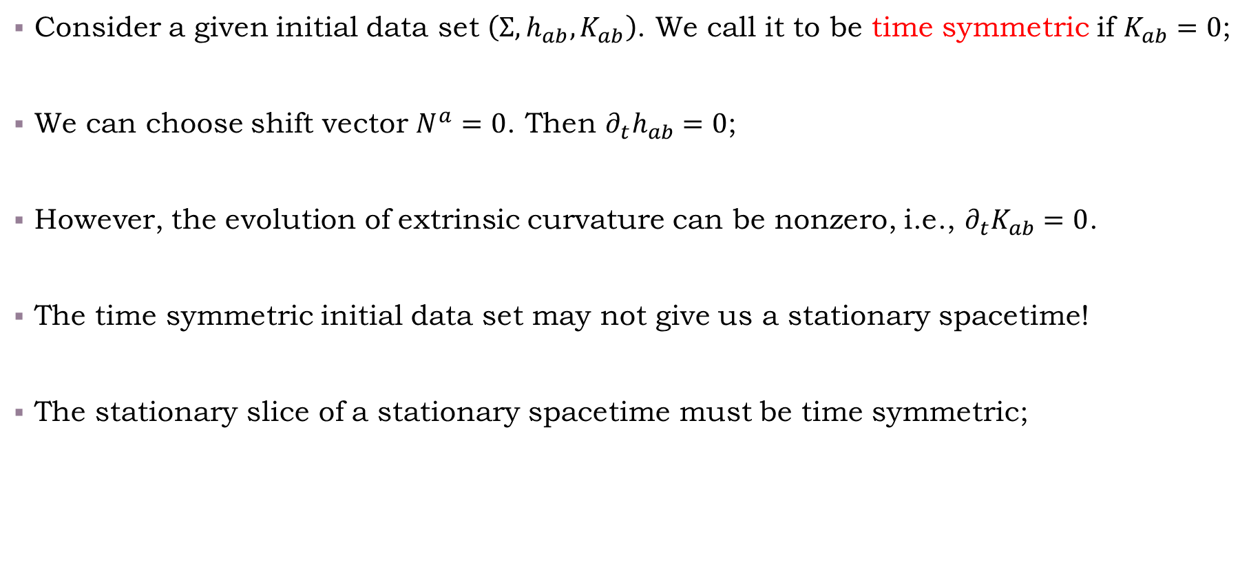
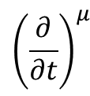
Proofs in time symmetric case
Consider a given initial data set $\left(Σ, h_{ab}, K_{ab}\right)$. We call it to be time symmetric if $K_{ab}=0$;
We can choose shift vector $N^{a}=0$. Then $∂_{t}h_{ab}=0$;
However, the evolution of extrinsic curvature can be nonzero, i.e., $∂_{t}K_{ab}=0$.
The time symmetric initial data set may not give us a stationary spacetime!
The stationary slice of a stationary spacetime must be time symmetric;
$${\left(\frac{∂}{∂t}\right)}^{μ}$$
$$\left(Σ, h_{ab}, K_{ab}\right)$$

Slide 10

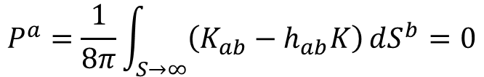

Proofs in special cases
There are a few of properties for time symmetric initial data set:
The ADM momentum is zero, so the ADM energy is same as the ADM mass;
$$dS^{a}$$
$$P^{a}=\frac{1}{8π}\int_{S→∞}{\left(K_{ab}−h_{ab}K\right)}dS^{b}=0$$
The momentum constraint is trivial and Hamiltonian constraint reduces into
The DEC and WEC are same in this case;
The apparent horizon becomes a minimal surface of initial data set with zero mean curvature.
$R=16πρ$.

Slide 11
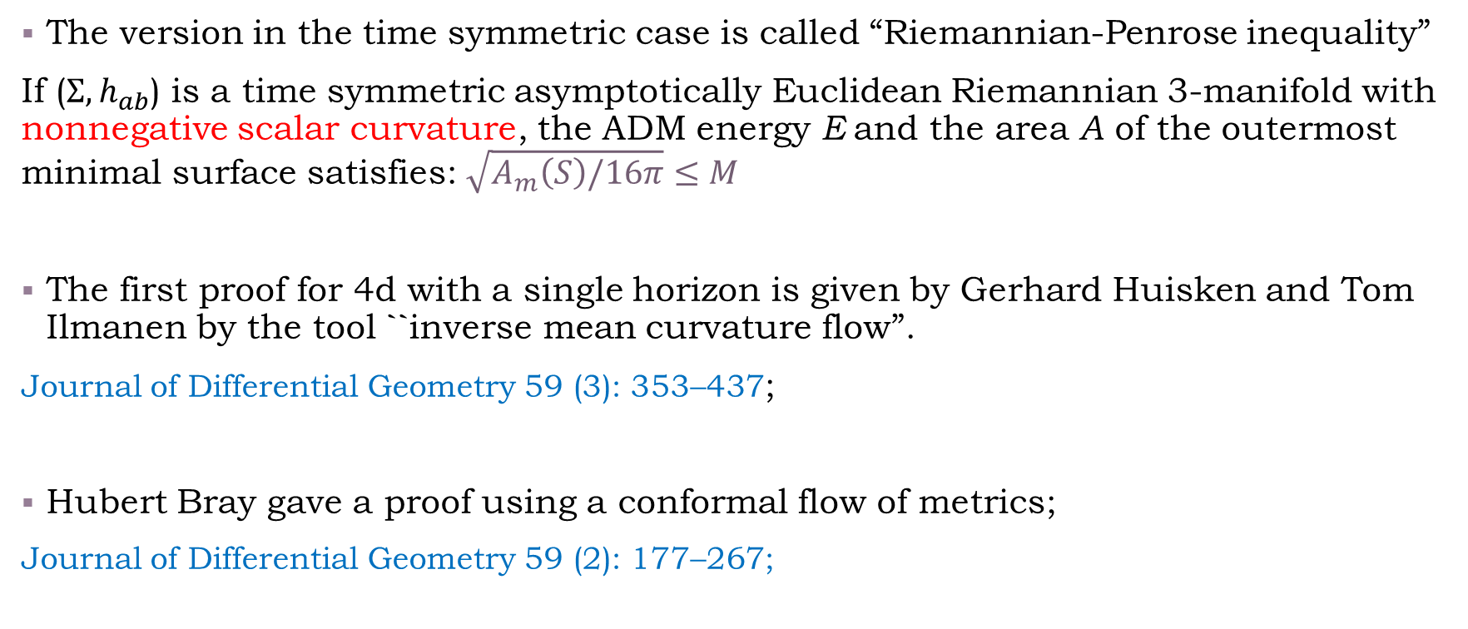
Proofs in time symmetric case
DEC (in fact we only need WEC) insures it
The version in the time symmetric case is called “Riemannian-Penrose inequality”
If ($Σ, h_{ab}$) is a time symmetric asymptotically Euclidean Riemannian 3-manifold with nonnegative scalar curvature, the ADM energy E and the area A of the outermost minimal surface satisfies: $\sqrt{A_{m}\left(S\right)/16π}≤M$
The first proof for 4d with a single horizon is given by Gerhard Huisken and Tom Ilmanen by the tool ``inverse mean curvature flow”.
Journal of Differential Geometry 59 (3): 353–437;
Hubert Bray gave a proof using a conformal flow of metrics;
Journal of Differential Geometry 59 (2): 177–267;
There are also some different proofs, such as spinor method, isoperimetric surfaces and so on.

Slide 12

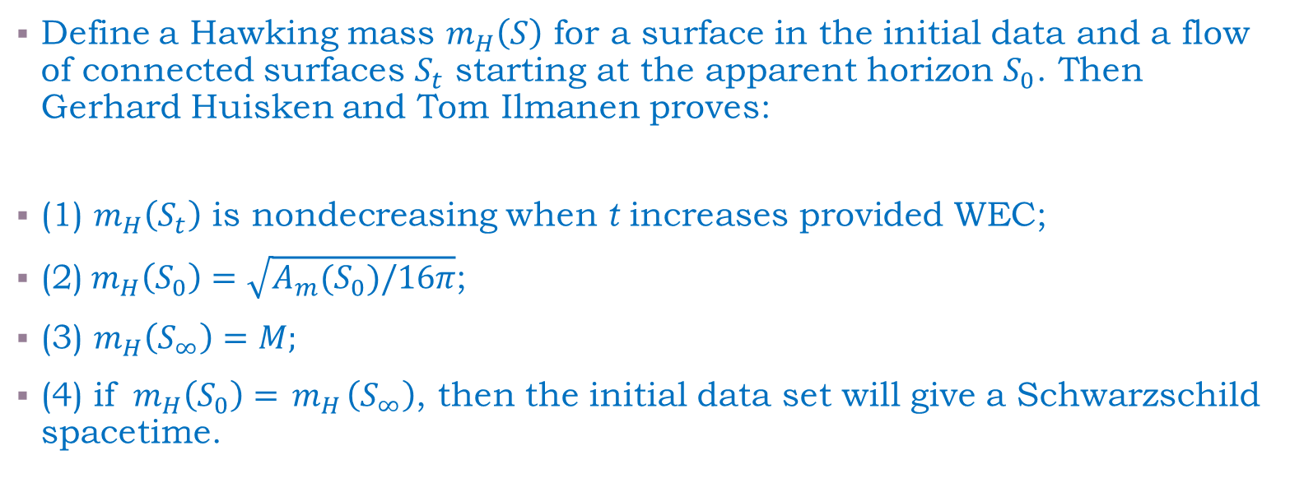
Proofs in time symmetric case
Overview on the proof finished Gerhard Huisken and Tom Ilmanen:
Define a Hawking mass $m_{H}\left(S\right)$ for a surface in the initial data and a flow of connected surfaces $S_{t}$ starting at the apparent horizon $S_{0}$. Then Gerhard Huisken and Tom Ilmanen proves:
(1) $m_{H}\left(S_{t}\right)$ is nondecreasing when t increases provided WEC;
(2)${ m}_{H}\left(S_{0}\right)=\sqrt{A_{m}(S_{0})/16π}$;
(3) $m_{H}\left(S_{∞}\right)=M;$
(4) if ${ m}_{H}\left(S_{0}\right)={ m}_{H}\left(S_{∞}\right)$, then the initial data set will give a Schwarzschild spacetime.
$$\sqrt{A_{m}\left(S\right)/16π}≤M$$
The most important conception in this proof are “inverse mean curvature flow” and its weak form

Slide 13
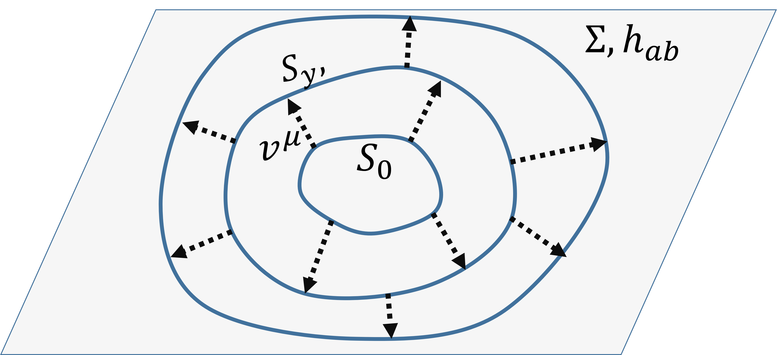
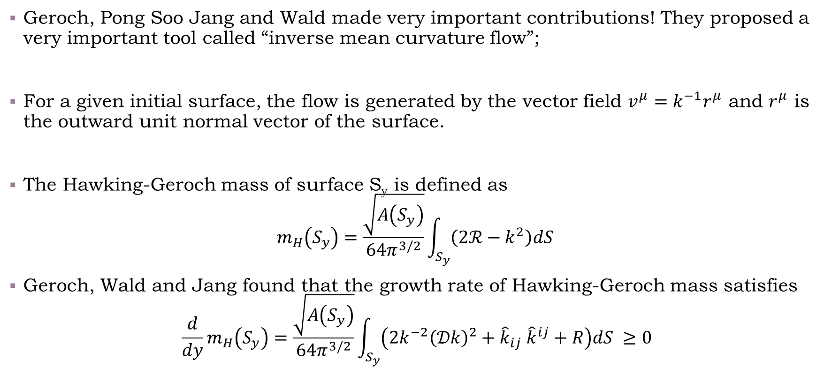
Proofs in special cases
What is inverse mean curvature flow?
Geroch, Pong Soo Jang and Wald made very important contributions! They proposed a very important tool called “inverse mean curvature flow”;
For a given initial surface, the flow is generated by the vector field $v^{μ}=k^{−1}r^{μ}$ and $r^{μ}$ is the outward unit normal vector of the surface.
The Hawking-Geroch mass of surface S_{y} is defined as
$$m_{H}\left(S_{y}\right)=\frac{\sqrt{A\left(S_{y}\right)}}{64π^{3/2}}\int_{S_{y}}{\left(2ℛ−k^{2}\right)dS }$$
Geroch, Wald and Jang found that the growth rate of Hawking-Geroch mass satisfies
$$\frac{d}{dy}m_{H}\left(S_{y}\right)=\frac{\sqrt{A\left(S_{y}\right)}}{64π^{3/2}}\int_{S_{y}}{\left(2k^{−2}{\left(𝒟k\right)}^{2}+{\hat{k}}_{ij} {\hat{k}}^{ij}+R\right)dS }≥0$$
The “inverse mean curvature flow” may become singular before they reach infinity;

Slide 14
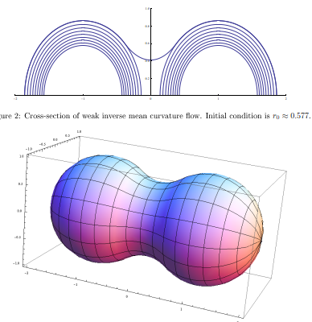
However, the “inverse mean curvature flow” may become singular before they reach infinity;
Gerhard Huisken and Tom Ilmanen developed ``weak inverse mean curvature flow’’ to overcome this issue and gives a first mathematically rigorous proof.

Slide 15
Proofs in special cases
Some important geometric flows in physics
Inverse mean curvature flow and “weak inverse mean curvature flow”
Geroch, Pong Soo Jang, Wald, Gerhard Huisken and Tom Ilmanen ……
Tool for proving Penrose inequality
Conformal flow
H.L. Bray
Powerful tool for proving Penrose inequality
Ricci flow
Richard Hamilton, Grigori Perelman ……
The renormalization group flow of the bosonic string sigma-model;
The tool for proving Poincaré conjecture;

Slide 16
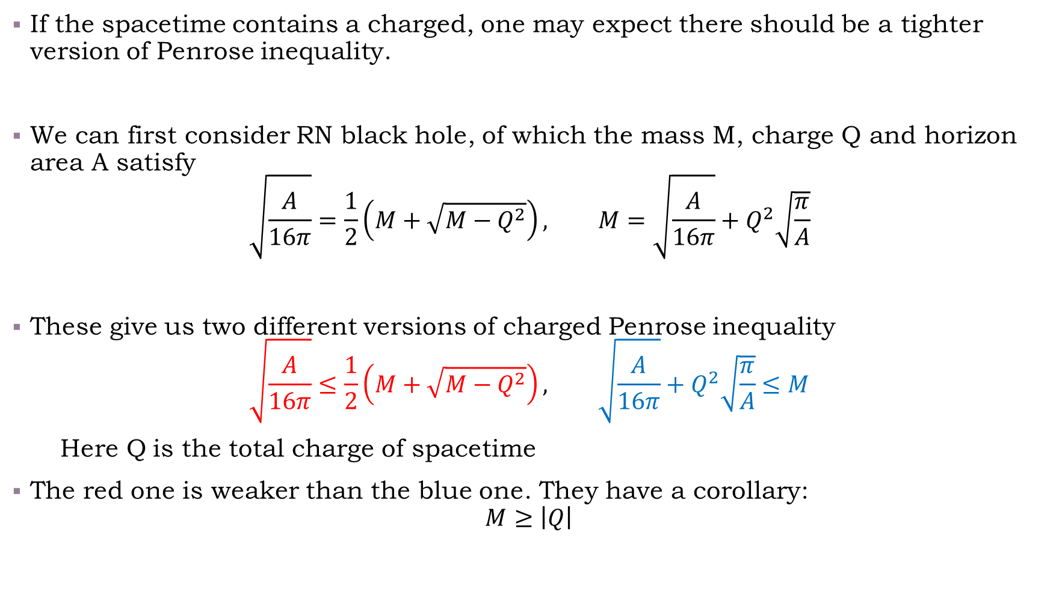
Generalization on charged case
If the spacetime contains a charged, one may expect there should be a tighter version of Penrose inequality.
We can first consider RN black hole, of which the mass M, charge Q and horizon area A satisfy
$$\sqrt{\frac{A}{16π}}=\frac{1}{2}\left(M+\sqrt{M−Q^{2}}\right), M=\sqrt{\frac{A}{16π}}+Q^{2}\sqrt{\frac{π}{A}}$$
These give us two different versions of charged Penrose inequality
$$\sqrt{\frac{A}{16π}}≤\frac{1}{2}\left(M+\sqrt{M−Q^{2}}\right), \sqrt{\frac{A}{16π}}+Q^{2}\sqrt{\frac{π}{A}}≤M$$
Here Q is the total charge of spacetime
The red one is weaker than the blue one. They have a corollary:
$$M≥\left|Q\right|$$

Slide 17
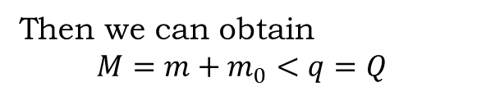
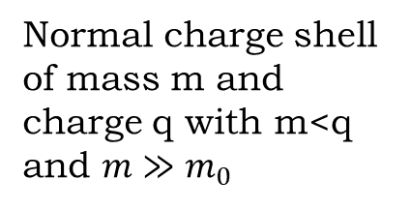
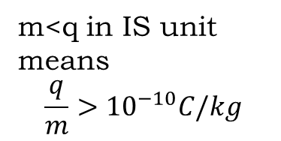
Generalization on charged case
The red charged generalization has been proved in time symmetric case when the matters do not carry charge (electrovacuum).
However, if the matters carry charge, both these two versions are not generally true.
Such a counterexample is not hard to be found.
Normal charge shell of mass m and charge q with m<q and $m≫m_{0}$
Then we can obtain
$$M=m+m_{0}<q=Q$$
Black hole m₀
Thus, we may obtain a static spherically symmetric black hole, of which the mass and charge satisfy M<Q
m<q in IS unit means
$$\frac{q}{m}>{10}^{−10}C/kg$$

Slide 18

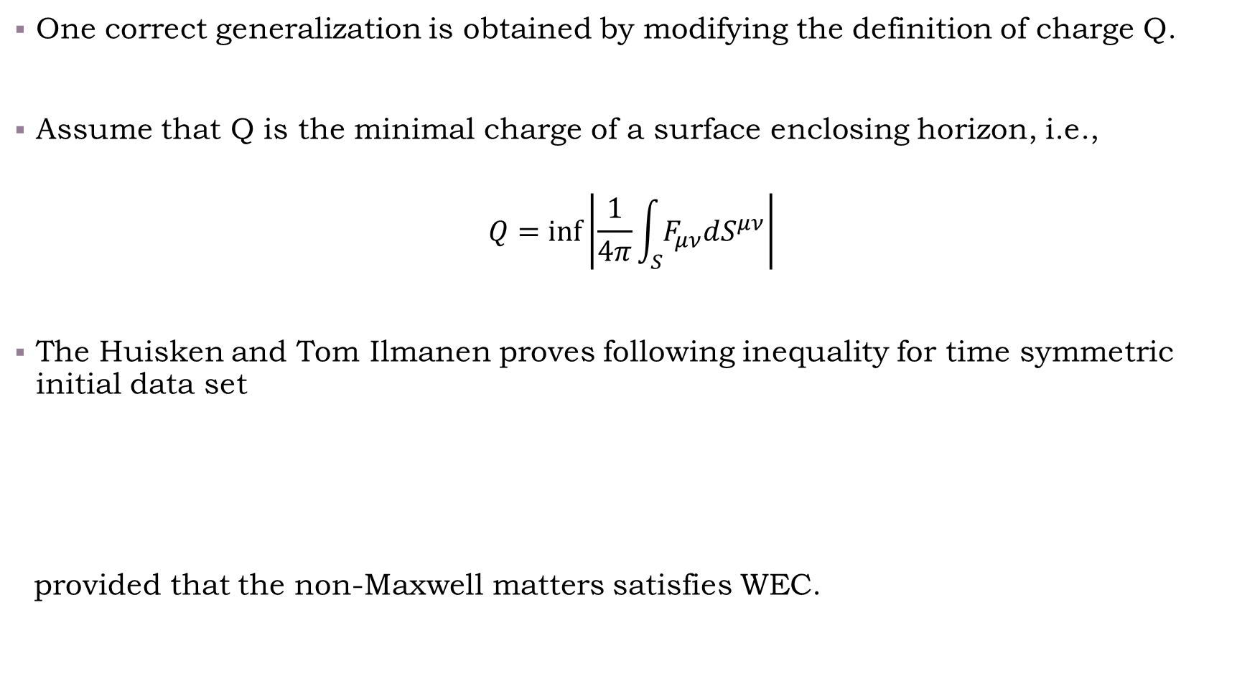
Generalization on charged case
One correct generalization is obtained by modifying the definition of charge Q.
Assume that Q is the minimal charge of a surface enclosing horizon, i.e.,
$$Q=\inf\left|\frac{1}{4π}\int_{S}{F_{μν}dS^{μν}}\right|$$
The Huisken and Tom Ilmanen proves following inequality for time symmetric initial data set
provided that the non-Maxwell matters satisfies WEC.
The Q here is neither total charge nor the charge contained inside black hole!
$$\sqrt{\frac{A}{16π}}+Q^{2}\sqrt{\frac{π}{A}}≤M$$

Slide 19
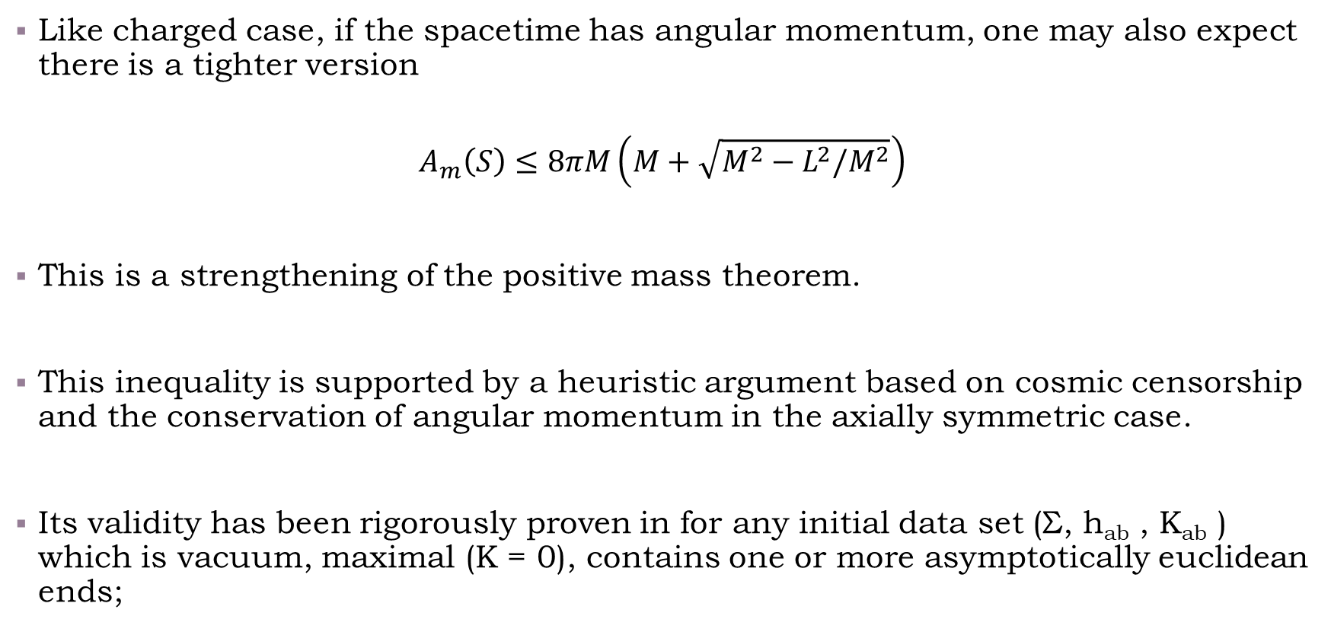
Generalization on rational case
Like charged case, if the spacetime has angular momentum, one may also expect there is a tighter version
$$A_{m}\left(S\right)≤8πM\left(M+\sqrt{M^{2}−L^{2}/M^{2}}\right)$$
This is a strengthening of the positive mass theorem.
This inequality is supported by a heuristic argument based on cosmic censorship and the conservation of angular momentum in the axially symmetric case.
Its validity has been rigorously proven in for any initial data set (Σ, h_{ab} , K_{ab} ) which is vacuum, maximal (K = 0), contains one or more asymptotically euclidean ends;

Slide 20
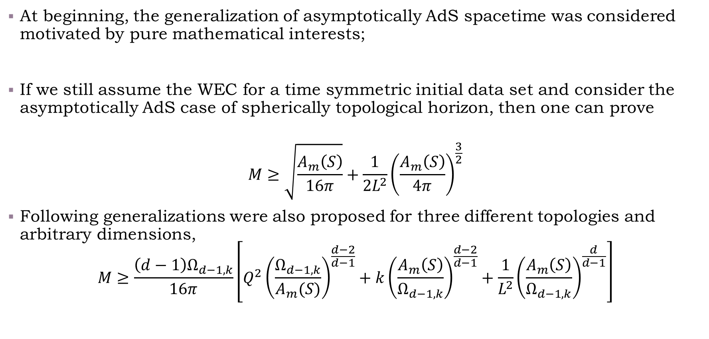
Generalizations to asymptotically AdS case (before holography)
At beginning, the generalization of asymptotically AdS spacetime was considered motivated by pure mathematical interests;
If we still assume the WEC for a time symmetric initial data set and consider the asymptotically AdS case of spherically topological horizon, then one can prove
$$M≥\sqrt{\frac{A_{m}\left(S\right)}{16π}}+\frac{1}{2L^{2}}{\left(\frac{A_{m}\left(S\right)}{4π}\right)}^{\frac{3}{2}}$$
Following generalizations were also proposed for three different topologies and arbitrary dimensions,
$$M≥\frac{\left(d−1\right)Ω_{d−1,k}}{16π}\left[Q^{2}{\left(\frac{Ω_{d−1,k}}{A_{m}(S)}\right)}^{\frac{d−2}{d−1}}+k{\left(\frac{A_{m}\left(S\right)}{Ω_{d−1,k}}\right)}^{\frac{d−2}{d−1}}+\frac{1}{L^{2}}{\left(\frac{A_{m}\left(S\right)}{Ω_{d−1,k}}\right)}^{\frac{d}{d−1}}\right]$$

Slide 21
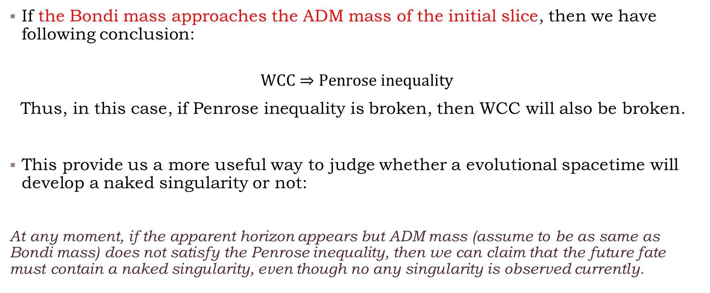
An additional comment
Relationship between Penrose inequality and WCC
If the Bondi mass approaches the ADM mass of the initial slice, then we have following conclusion:
$$WCC⇒Penrose inequality$$
Thus, in this case, if Penrose inequality is broken, then WCC will also be broken.
This provide us a more useful way to judge whether a evolutional spacetime will develop a naked singularity or not:
At any moment, if the apparent horizon appears but ADM mass (assume to be as same as Bondi mass) does not satisfy the Penrose inequality, then we can claim that the future fate must contain a naked singularity, even though no any singularity is observed currently.

Slide 22
A few of recent progresses
Relationship between Penrose inequality and NEC
From the Penrose’s heuristic argument, we see that seemingly only NEC is used, but above proofs all assume DEC or WEC;
This raises an interesting question: is it possible to prove Penrose inequality by only using NEC?
There are bad news and good news on this issues;
Under NEC, the counterexamples of Penrose inequality in spherically time symmetric case have been found for both asymptotically flat and AdS spacetime;

Slide 23


A few of recent progresses
Relationship between Penrose inequality and NEC
However, if we require that the initial data set is not only time symmetric but also static, then the situation will be different;
In spherically symmetric static spacetime, we now can prove Penrose inequality for arbitrary dimensional asymptotically flat spacetimes;
Time symmetric $\left(Σ,h_{ab},K_{ab}\right)$: $K_{ab}=0;$
Static $\left(Σ,h_{ab},K_{ab}\right)$: $K_{ab}=0, ∂_{t}K_{ab}=0$
2205.08246 ;

Slide 24
A few of recent progresses
Penrose inequality in holography
There are 4 differences at least:
Energy condition:
Holography does not favorite DEC or WEC since mass of field in physical interesting situation often is negative.
The Penrose inequality under NEC is physically needed.
Definition of mass
Holographic renormalization leads that the mass of spacetime depends on the choice of quantization.
Consequences of volitation
The volitation of Penrose inequality may lead to naked singularity (???), which is forbidden by holography principle.
Boundary condition
The spacetime is not globally hyperbolic, so boundary condition at infinity is needed.

Slide 25
Energy condition
Horowitz gives a holographic argument for Penrose inequality, of which only NEC is involved;
If the spacetime is asymptotically Schwarzschild AdS, the paper of Xiao shows that NEC can insure the Penrose inequality at least for static planar and spherically symmetric black holes;
If we abounded the requirement of static, the counterexamples have been found by Folkestad in spherically symmetric case;
It is not clear that if NEC can guarantee the Penrose inequality for general static and stationary cases or not.

Slide 26
Holographic swampland condition?
Let us focus on spherically or planar symmetric case:
produce a violation of weak cosmic censorship
Whence Penrose inequality is broken
oscillate forever, never settling down to a static black hole
The study of gravitational collapse in AdS spacetime shows that black hole will always form
Any well-defined bulk theory which has holographic dual must stratify following criteria:
Its planar or spherically symmetric initial data set with source free boundary condition should not violate the Penrose inequality.

Slide 27
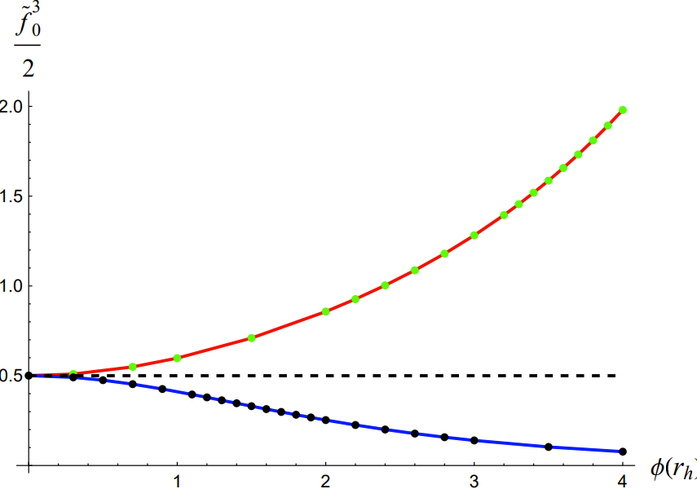
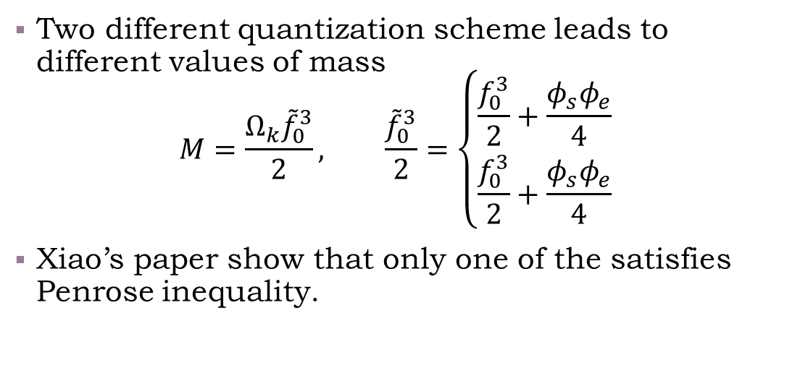
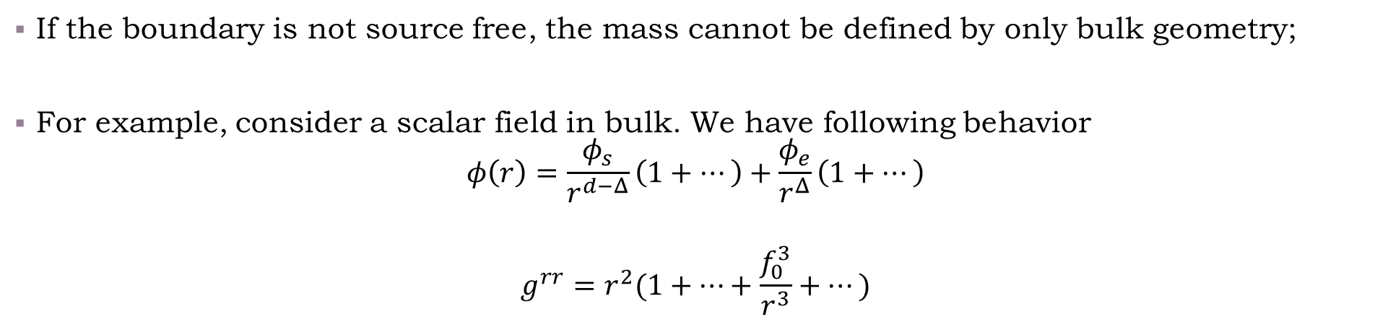
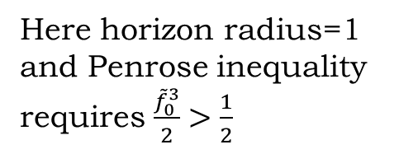
Definition of mass
If the boundary is not source free, the mass cannot be defined by only bulk geometry;
For example, consider a scalar field in bulk. We have following behavior
$$φ\left(r\right)=\frac{φ_{s}}{r^{d−Δ}}\left(1+⋯\right)+\frac{φ_{e}}{r^{Δ}}\left(1+⋯\right)$$
$$g^{rr}=r^{2}(1+⋯+\frac{f_{0}^{3}}{r^{3}}+⋯)$$
Here horizon radius=1 and Penrose inequality requires $\frac{{\tilde{f}}_{0}^{3}}{2}>\frac{1}{2}$
Two different quantization scheme leads to different values of mass
$$M=\frac{Ω_{k}{\tilde{f}}_{0}^{3}}{2}, \frac{{\tilde{f}}_{0}^{3}}{2}=\left\{\begin{aligned}\frac{f_{0}^{3}}{2}+\frac{φ_{s}φ_{e}}{4} \\ \frac{f_{0}^{3}}{2}+\frac{φ_{s}φ_{e}}{4}\end{aligned}\right.$$
Xiao’s paper show that only one of the satisfies Penrose inequality.

Slide 28
Further questions
Can NEC insure Penrose inequality for static and stationary asymptotically flat black hole?
If its true, we then obtain a new “positive mass theory” for black holes with only NEC.
Does most-frequently used holographic models sink into the swampland created by Penrose inequality?
Saying free scalar field model of negative mass-square, holographic superconducting models and so on……
Can we redefine the mass suitably when source is nonzero so that Penrose inequality is still satisfied?

Slide 29
thanks a lot~

